Slide 1

A look into nationwide mortality rates and the possible effect on healthcare costs

Slide 2

AGENDA
Aim of the Project
Foundational Questions
Chronic Disease Mortality Rates Across the United States
Mortality Rates Across the United States
Healthcare Costs by Region
Findings
Ethical Considerations

Slide 3

The aim of our project is to identify trends in healthcare outcomes. This project will look at the relationship between healthcare costs and death rates across the United States to find any correlation apparent that could show the following:

Slide 4

- Do higher mortality rates due to higher chronic illness lead to an increase in healthcare costs by region? - Do higher healthcare costs create a higher mortality rate due to inability to obtain proper healthcare? - What are the most cost friendly states to live in when it comes to healthcare?

Slide 5
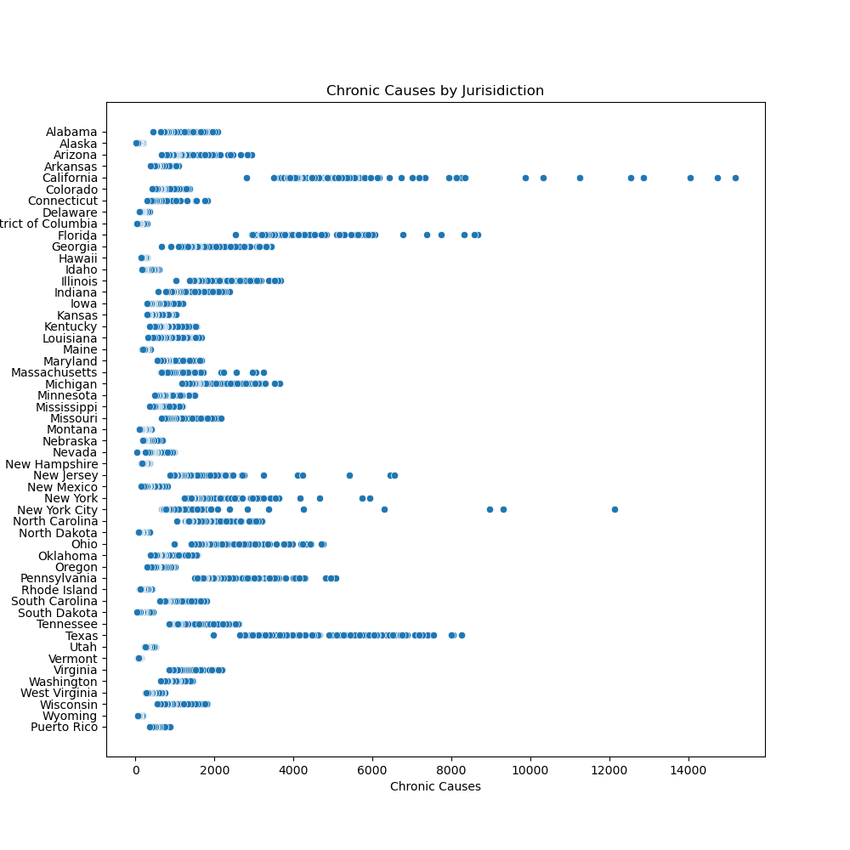
Chronic Disease Mortality Rates Across the United States

Slide 6
SELECTING VISUAL AIDS
ENHANCING YOUR PRESENTATION

Slide 7
EFFECTIVE DELIVERY TECHNIQUES
Effective body language enhances your message, making it more impactful and memorable.
Meaningful eye contact
Purposeful gestures
Maintain good posture
Control your expressions
This is a powerful tool in public speaking. It involves varying pitch, tone, and volume to convey emotion, emphasize points, and maintain interest.
Pitch variation
Tone inflection
Volume control

Slide 8
Findings
After reviewing the data in this project, we have come to the following conclusions:
The top 3 states in terms of healthcare costs are:
-
-
-
States that have a higher trend of chronic caused deaths tend to have higher healthcare costs, although a look at overall cost of living in said states may show an increase in overall costs which affects healthcare coverage as well,
Looking at higher insurance costs alone may not directly cause higher mortality, they do correlate with more broad health system performance, access to care, and overall quality of life.

Slide 9

Ethical COnsiderations
Your ability to communicate effectively will leave a lasting impact on your audience
Effectively communicating involves not only delivering a message but also resonating with the experiences, values, and emotions of those listening

Slide 10

Thank you

